Slide 1
Predicting Income Statement Accounts Using Machine Learning
Diego Messmacher & Holden Cormier

Slide 2
Problem Statement and Potential Solution
Problem:
Stocks trade on potential of future earnings and being able to predict what a company's future looks like will give you a significant advantage when doing stock analysis.
Proposed solution:
Public software companies generally follow similar growth rates so using historical income statements from software companies a prediction can be made about the next year of a target company. Our goal was to make a different model for each account on the income statement using the same accounts from other income statements.

Slide 3
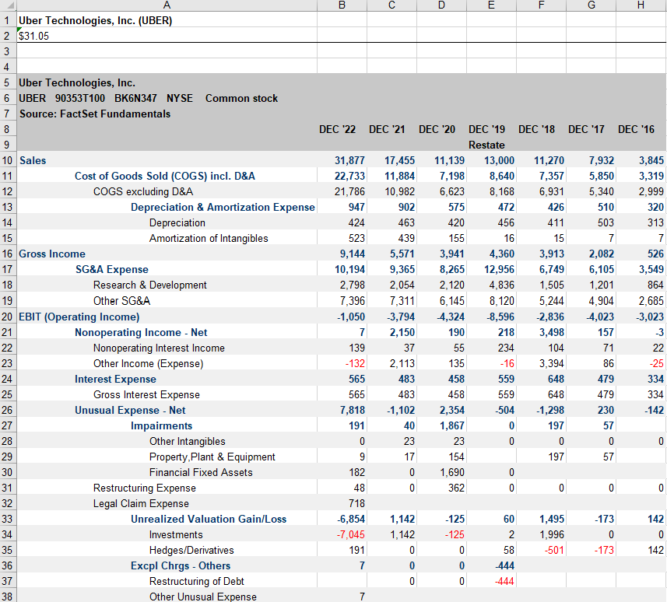
Data
Our data consisted of 35 company income statements. Each company represented a feature and the specific line items were the data.

Slide 4
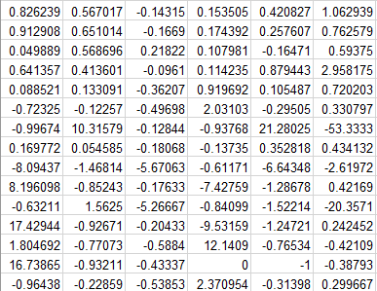
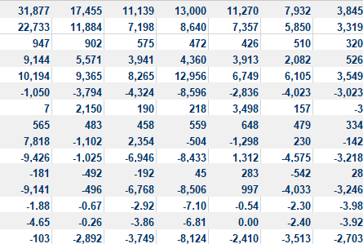
Data Cont.
The income statements were consolidated so only the summary accounts were used.
These summary accounts were then converted to growth rates.

Slide 5
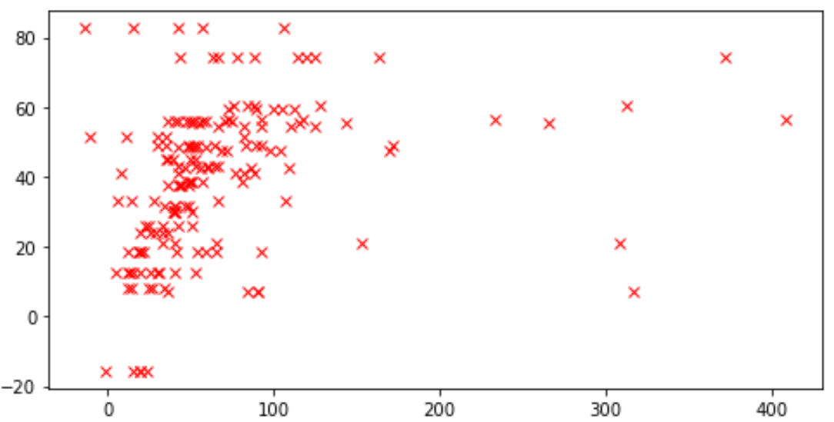
Data Cont.
Our biggest limiter was our data because each feature could only have five data points.
Some income statements ended up leading being outliers for what we wanted to achieve and because of the limited nature of our dataset they had significant impact

Slide 6

Models
Linear
Polynomial
Neural Network

Slide 7
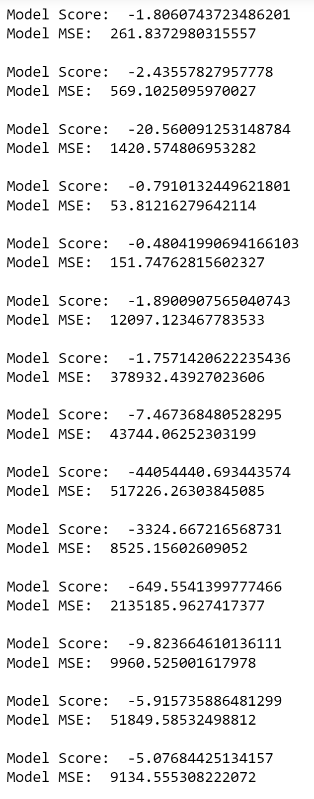
Linear
For the linear model we used sklearn’s linear regression package. After getting the data in a usable format we trained a linear regression model on the training data. Our best linear model was predicting revenue and ended with a mean squared error of 260 and a score of -1.8 and the worst mean squared error was 2135185.9627417377 with a score of -690 .

Slide 8
Example prediction – mongodb revenue growth
Revenue Numbers:
Our prediction: 52% growth for 2023
Actual: 54% growth for 2023

Slide 9
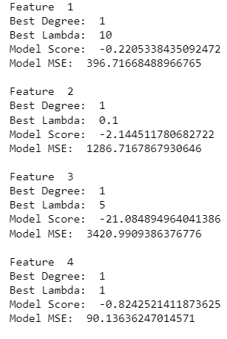
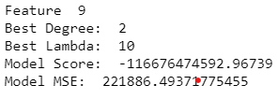
Polynomial
For the polynomial model we used ridge regression to lower overfitting. After testing for the best degree and lambda, only 2 out of the 14 features performed better with a degree higher than one. Funnily enough, this was also the worse performing feature with a score of -1000000000 and an MSE of 200000 while the best feature had a score of -0.8 and MSE of 90. We noticed that the model actually performed better with less data points although this is probably a result of overfitting rather than anything else.

Slide 10
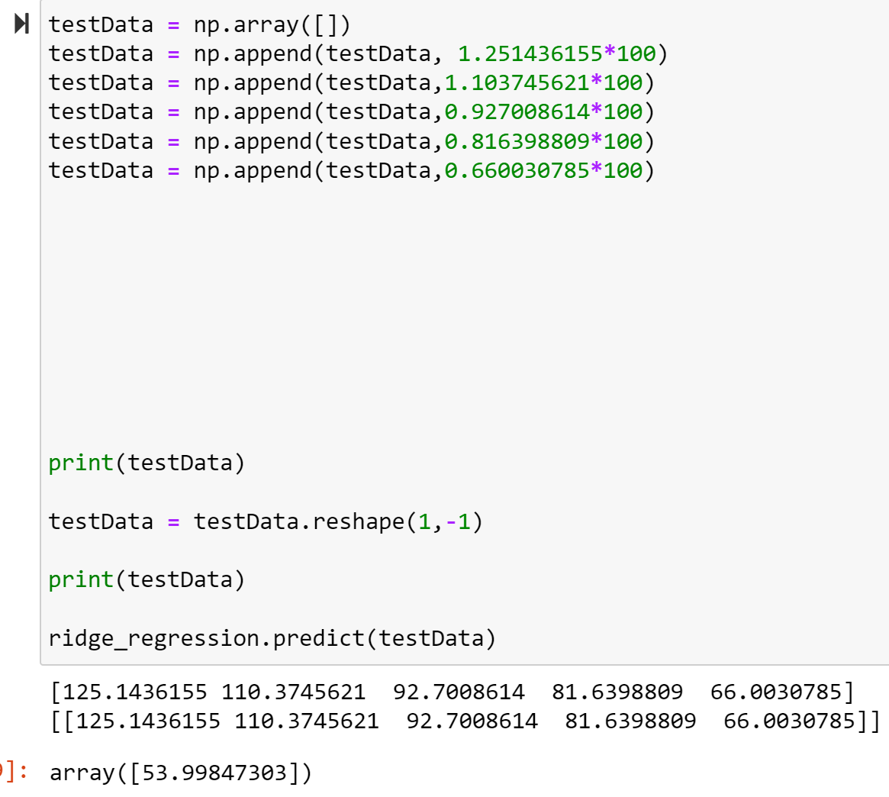
Example prediction – mongodb revenue growth
Revenue Numbers:
Our prediction: 54% growth for 2023
Actual: 54% growth for 2023

Slide 11
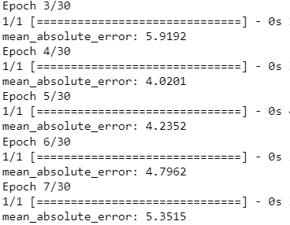
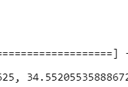
Neural Network
In the neural network model we made a deep neural network using Tensorflow’s Keras package. We used a sequential model and then used the RandomizedSearchCV in order to find the best hidden layers, learning rate and number of neurons. We only did it for feature 4 as it would’ve taken way too long if we did all 14 features. Although this model performed quite well on the validation dataset it was it did not when we tried using the model with the test data.

Slide 12
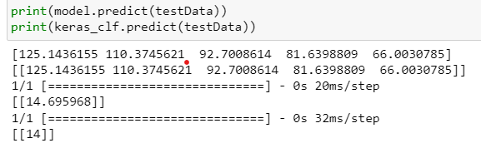
Example prediction – mongodb revenue growth
Revenue Numbers:
Our prediction: 14.7% growth for 2023
Actual: 54% growth for 2023

Slide 13
Limitations
Data limitations
Only having 5 data points for each feature significantly reduced the accuracy of our model
Could not consistently predict correct values because of this
Only solution would be to use data as one feature because our thesis relies on the progression over five years
Computational limitations
We were unable to create models for the 14 different accounts using a neural network because of our computational limitations
Each model had a very long runtime and we did not have enough time to run it 14 different times with 14 different data sets
Possible solutions would be more time and a better computer

Slide 14

Conclusion
Although this project was inconclusive at best, we believe that this is due to the limited dataset rather than there being no correlation software company’s financial statements. As it stands the best performing model was the polynomial model. Our predictor ended up working well for companies that very closely matched our ideal software company income statement.

Slide 15
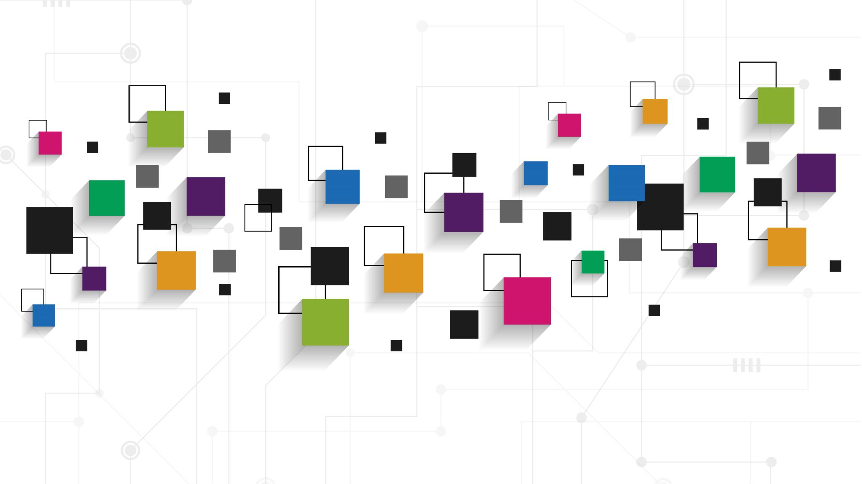
Future Work
We still feel that our original thesis was correct
Use each account as their own feature
Split data into months or quarters
Remove outlier income statements to yield a more accurate result

